Slide 1
WELCOME TO MY PRESENTATION
NAME:SHUVO HALDER
ID:213-15-4369
PC-(C)

Slide 2
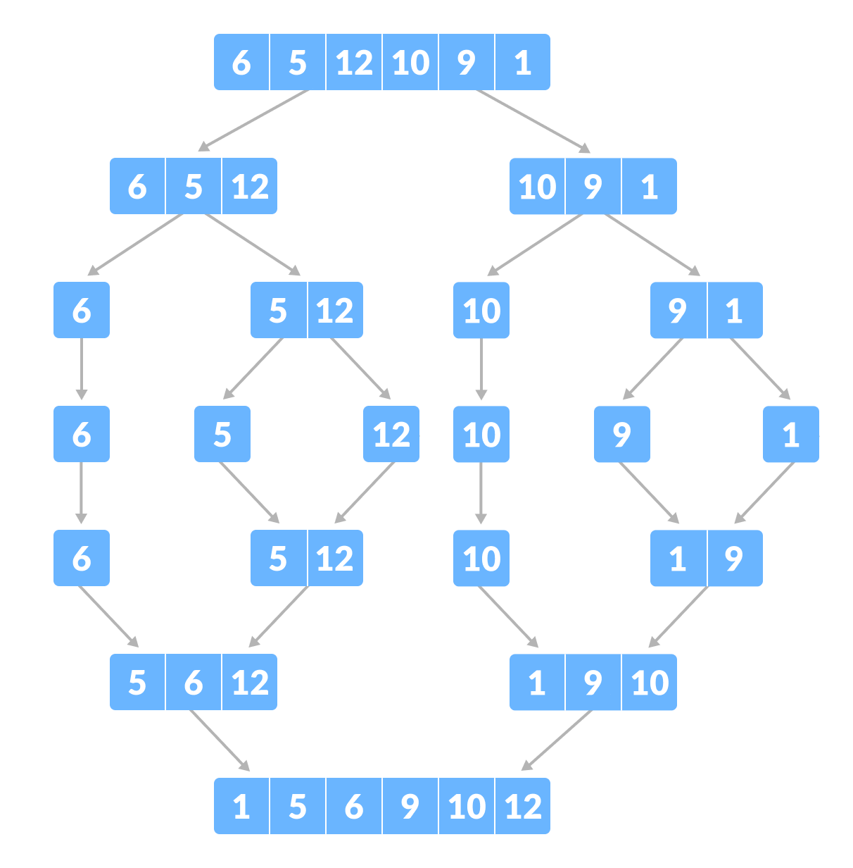
MERGE SHORT
The Merge Sort algorithm is a sorting algorithm that is based on the Divide and Conquer paradigm. In this algorithm, the array is initially divided into two equal halves and then they are combined in a sorted manner.

Slide 3
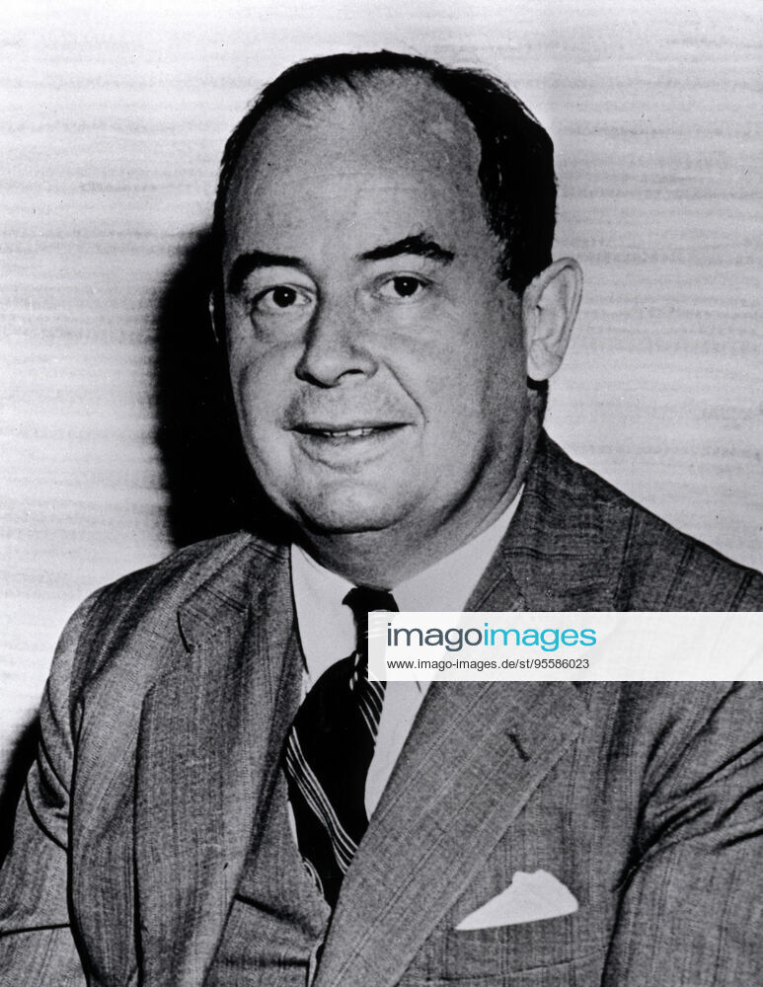
BEGINNING:
Invented By JOHN VON NEUMANN(1903-1957)
FOLLOWS divide and conquer paradigm.
Developed merge sort for EDVAC IN 1945.

Slide 4
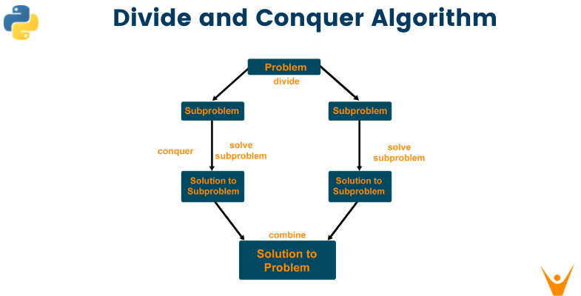
DIVIDE AND CONQUER:
Divide the problem into a number of subproblems that are smaller instances of the same problem.
Conquer the subproblems by solving them recursively. If they are small enough, solve the subproblems as base cases.
Combine the solutions to the subproblems into the solution for the original problem.

Slide 5
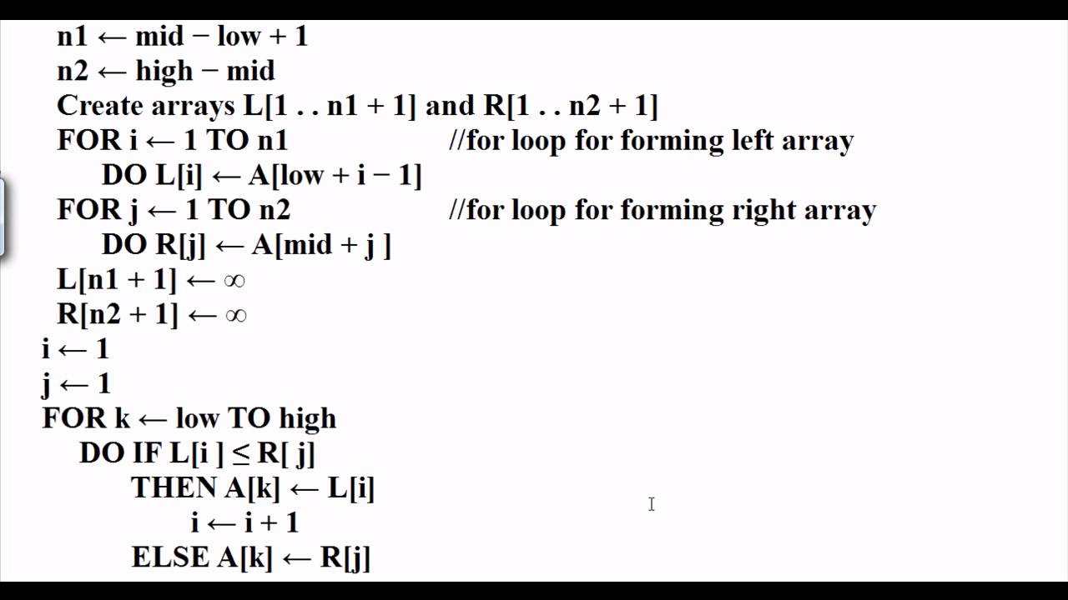
MERGE SORT ALGO:
Find the middle index of the array to divide it in two halves: m = (l+r)/2.
Call MergeSort for first half: mergeSort(array, l, m)
Call mergeSort for second half: mergeSort(array, m+1, r)
Recursively, merge the two halves in a sorted manner, so that only one sorted array is left:

Slide 6
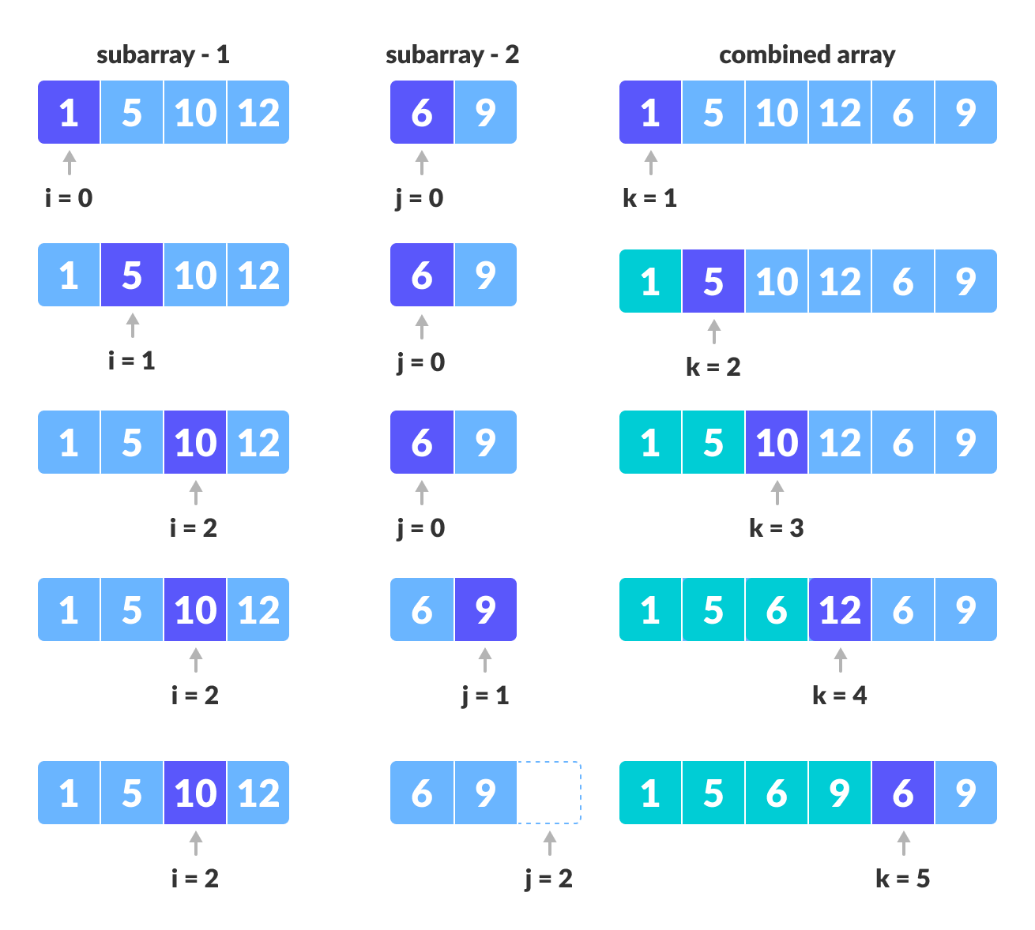
MERGE SORT EXAMPLE:

Slide 7

T

